Slide 1
Accounting Summit
- e-Invoicing and tax determination:
How the changed tax regulations affect the AP process
04 September 2025

Slide 2
Agenda
Intro
How invoice formats impacting VAT-reporting capabilities
What challenges do regulatory developments in Germany and beyond bring with them?
How can Vertex support you?
What are the advantages of the changed legal framework?

Slide 3

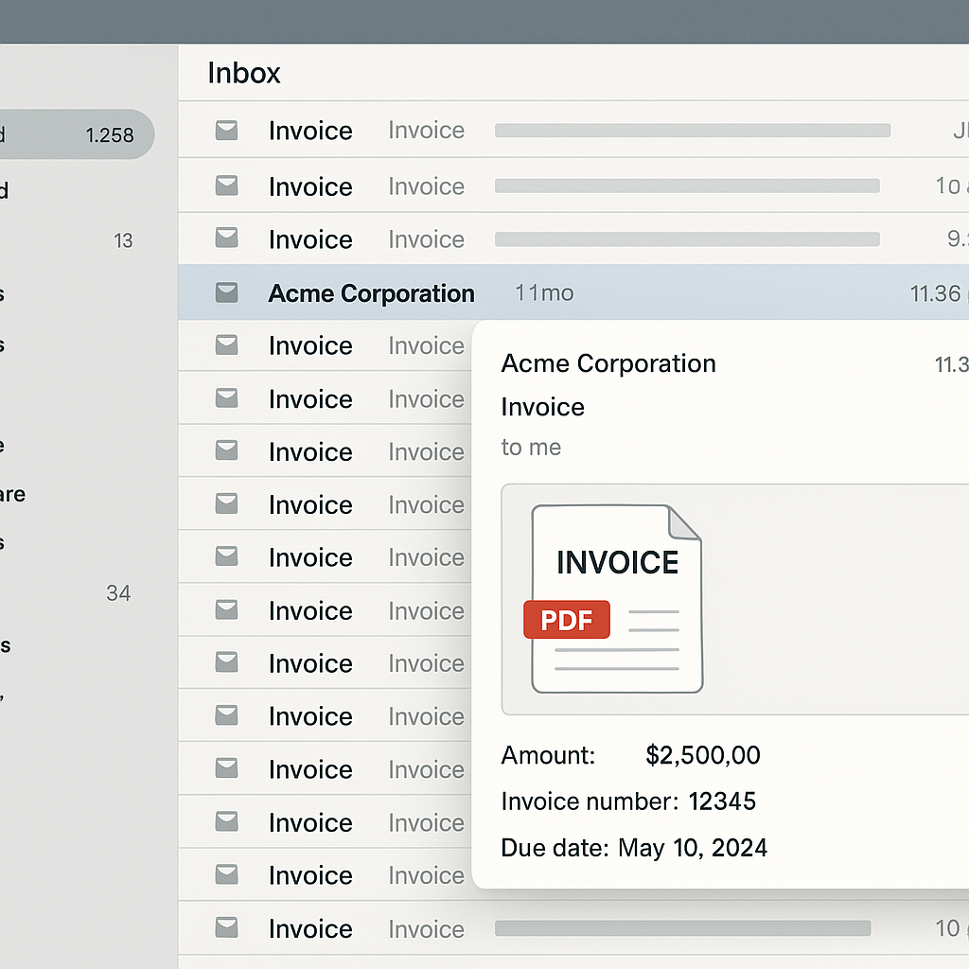

How different invoice formats impact VAT-reporting

Slide 4

How poor data impact AP-Automation and VAT-reporting
  Limited information available
  Poor invoice quality
  Manual invoice validation
AP-Automation
  Incorrect tax code determination for invoice posting
  Inaccurate data for
  VAT-reporting
  Time-consuming review and VAT corrections
  Poor matching results
  Long lead times
  Extensive approval processes
Invoice reception
VAT-reporting

Slide 5

Ongoing & upcoming changes – Wachstumschancengesetz & ViDA
2025
2026
2027
2028
Voluntary
e-Invoicing begins:
X-Rechnung
recommended
Mandatory
e-Invoicing for
B2B transactions:
PDF & paper no
longer accepted
Mandatory
e-Invoicing for
large B2B businesses:
Mandatory issuance of
e-Invoices for large enterprises in Germany
Full mandatory B2B e-Invoicing in Germany
2028 - 2035
Introduction of cross-border
e-Invoicing
Digital Reporting Requirements (DRR) go live
Full harmonization of e-Invoicing and VAT compliance across EU

Slide 6
















Mandatory e-Invoicing and VAT-reporting are on the rise in EU and beyond
Peppol: UBL
Germany
B2B e-Invoicing:
1 January 2025 (receiving)
1 January 2027 for companies with a turnover >800k EUR
1 January 2028 for all others (issuing)
Poland
B2B e-Invoicing:
1 February 2026 for taxpayers with a turnover exceeding PLN 200m in 2025
1 April 2026 for all other taxpayers
Romania
B2G e-Invoicing since 2022
B2B e-Invoicing from 1 July 2024
B2C e-Invoicing also now included in scope from 1 January 2025
Slovenia
B2B e-Invoicing from 1 June 2026
Spain
B2B e-Invoicing from spring 2026 (TBD)
Belgium
B2B e-Invoicing from 2026
France
B2B e-Invoicing:
1 September 2026 (receiving for all & issuing for large suppliers)
1 September 2027 (issuing for medium & small suppliers)
KSeF: FA2
2026
PPF (B2B) | Chorus Pro (B2G): CII, UBL, Factur-X
Peppol: xRechnung, ZUGFeRD
2026 - 2027
2025 - 2028
Peppol
2026
NAV: NAV XML 3.0
2021
FACe (B2G): FacturaE
B2B platform TBD
2026
RO e-Factura:
UBL, CII
2026
2024 - 2025
SEF: UBL, CII
ebInterface
SDI: FacturaPA
2023
2019

Slide 7
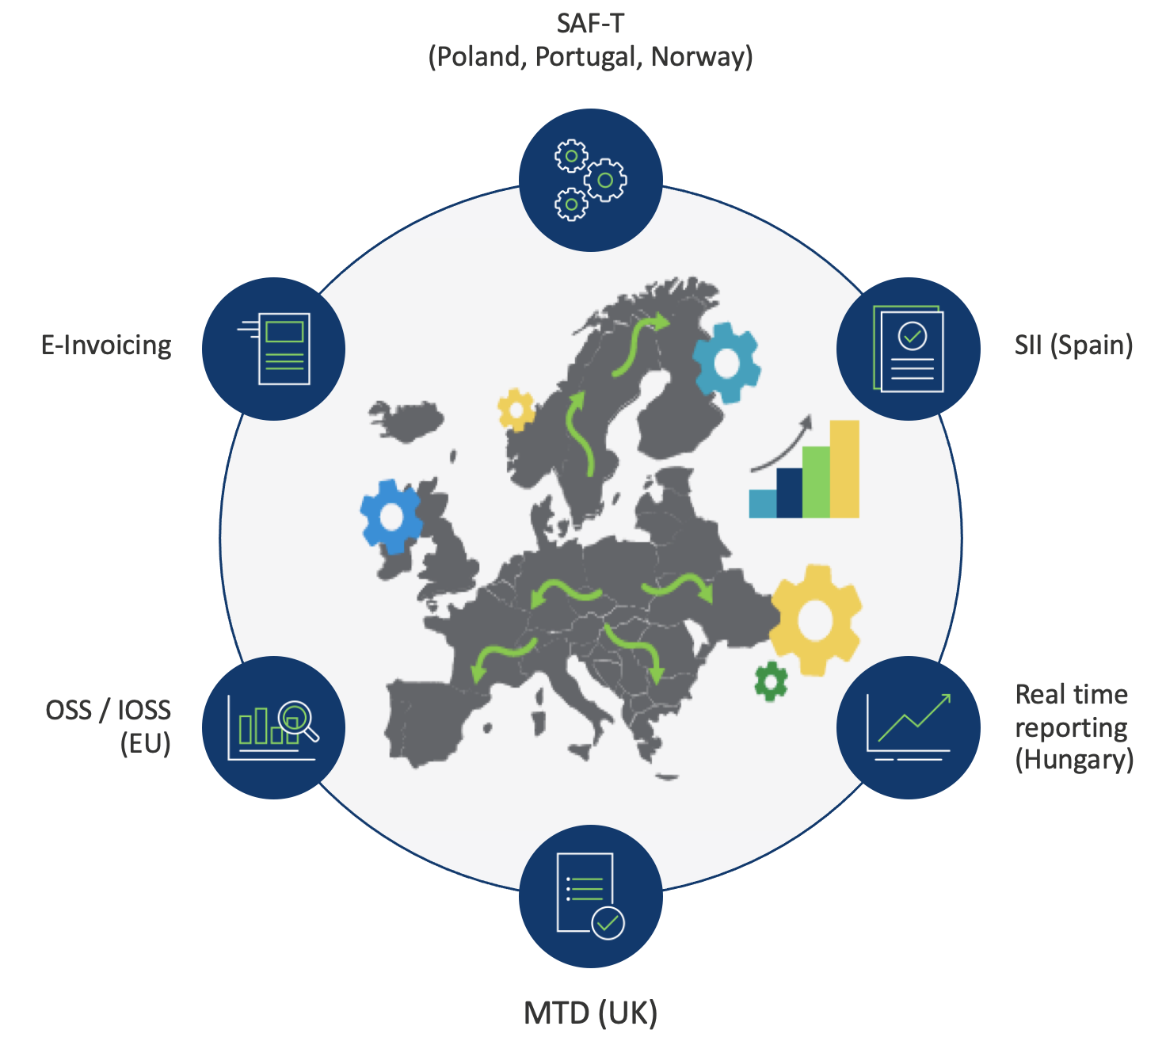

Developments that create new challenges

Slide 8






How can Vertex help?
45+
Years in
Tax Technology
60%
of the
Fortune 500
4,000+
Customers
150+
Integrations
Vertex Returns & Reporting Platform
Source Systems
100%
data
Quality
Line level Information
100+
Tax
Researchers
20,000+
Global Jurisdictions
Supported
Global Compliance
ensured
Statutory
Reports
1billion
Data-Driven
Effective Tax Rules
Vertex O Series
Tax Calculation Engine
Vertex e-Invoicing
Vertex VAT Compliance
VERX, IPO NASDAQ since 2020
© Vertex, Inc. All rights reserved.

Slide 9







Integrated Compliance: e-Invoicing & periodic reporting
Data Fabric
Vertex e-Invoicing
e-Invoice
transmission
Peppol
Access Point
Peppol Network
Vertex Returns
& Reporting
Customer
Source System(s)
Interoperability
API/SFTP/ Connectors
Invoice reconciliation
Country-specific e-Invoice creation & validation
Digital signature & archiving
Vertex Business Network
Certified Providers
Customer Delivery
VAT Compliance extractors
Vertex VAT Compliance
Workflow
Status
Consolidated Portal
Returns submission
(e-file or manual)
e-Invoice Exchange
(Real-time or Clearance)
B2B and B2G
Customers
Periodic & near-real-time reporting
e-File & PDF returns
Returns archiving
e-Invoicing reconciliation
Reporting
Vertex O Series
Tax Calculation Engine
Tax Authority
© Vertex, Inc. All rights reserved.

Slide 10

Automated tax code determination with Vertex
Calling system
REQUEST
ERP
Systems
RESPONSE
Who?
What?
Whom?
Where?
When?
VAT Amount
VAT Rate
Tax Code
Transactional classification
Vertex O Series
Tax Calculation Engine

Slide 11
End-to-end e-Invoice life-cycle from VAT perspective
e-Invoice reception
e-Invoice validation
AP-Automation process with posting
(ERP/3rd party)
Validate VAT amounts charged by vendor
Determination of VAT/GST
and Sales & Use tax
Tax code determination
(ERP agnostic)
Periodic VAT data
extraction
VAT return preparation
and submission
© Vertex, Inc. All rights reserved.
Notes:
Vertex is building the Global Tax Network of the Future, connecting the platforms, systems, and people to get the job done wherever transactions take place, scalable to grow wherever you go.
With Vertex, you’ll leverage an end-to-end global tax platform to manage:
Continually updated global tax content for the latest taxability rules.
Customer location identification and B2B validation.
Line-item taxability.
Calculation of sales, use, and value added tax including exemptions and cross-border logic.
Invoicing and payment services integrated to your transaction systems.
Tax returns and remittance.
Detailed reporting to help close audits faster and reduce penalties.
And data-driven insight to accelerate compliance, and drive business decisions
PRODUCTS
Tax Content:
Communications (Telco)
Leasing
Medical
Discretionary Fees
Business & Occupancy & Environmental
Location Identification & Registration ID Validation
Vertex Validator
Address Cleaning
Lat/Long Locator
Liability Determination
Vertex SMB online sellers (Non-US based)
Vertex for Marketplaces
Vertex for Ecommerce
Intra-regional, Inter-regional, & Cross-Border Calculation
Accelerators for SAP & Oracle
Certificate Center (dropship support)
Invoicing & Payment
Invoice IQ
Tax Returns & Remittance
E-Invoicing
VAT Compliance
SUT Compliance
Express Returns
Advantage Plus
Assure
System Reports, Analytics & Documentation
Certificate Center
Indirect Tax Intelligence
Roadmap: Tax Categorization
Consistent Structured Tax Data
The Vertex Portfolio

Slide 12

What are the advantages for AP and Tax departments?
  No supplier onboarding necessary
  Automated e-Invoice validation
  Header and line level data
  Consistent high invoice quality
AP-Automation
  Calculate and validate the VAT amount and automatically determine the correct tax code
  Faster and more accurate data for VAT-reporting
  Reconciliation from
  e-Invoices to VAT-reporting
  No need to replace current AP-workflow
  Better matching results
  Shorter lead times
  Less invoice approvals required
Global
e-Invoice reception
VAT-reporting
Global
E-Invoicing

Slide 13
Enterprise-wide impact of e-Invoicing requirements
Environmentally friendly
Reduce paper waste and carbon footprint significantly.
IT/Technology
Procurement
Cost savings
Reduce costs through automated processing, eliminated manual tasks, and consolidated system management for tangible savings.
Finance
Global
e-Invoicing
Supply Chain
Boost your competitive advantage
Strengthen business operations through efficient e-Invoicing, enabling seamless system connections and streamlined supplier-customer interactions.
Tax
Sales
Reduce risk
Expert monitoring, automated compliance updates, and proactive maintenance ensure uninterrupted operations.
Compliance
Legal
Save time
Automate repetitive tasks and remove manual intervention to accelerate invoice processing.

Slide 14





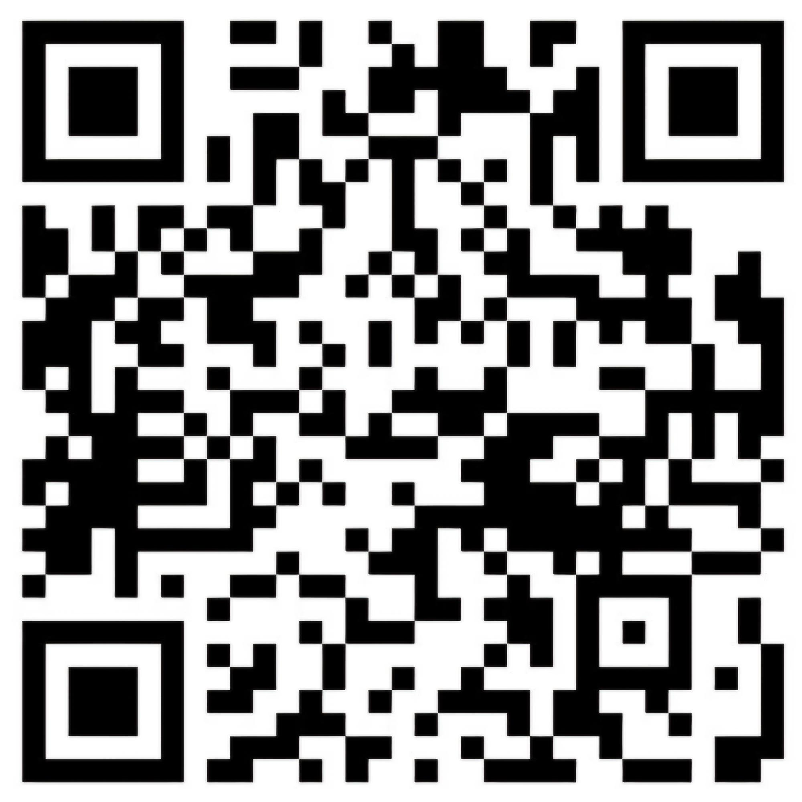
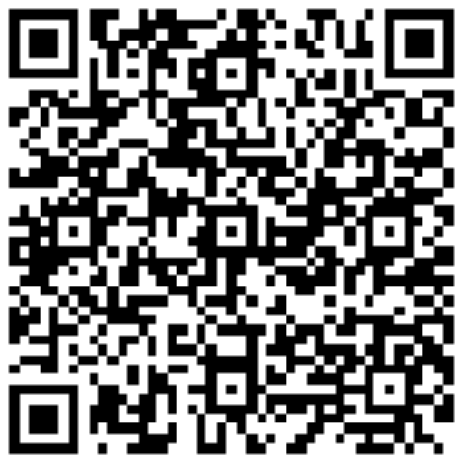
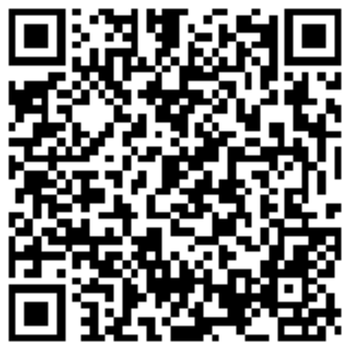
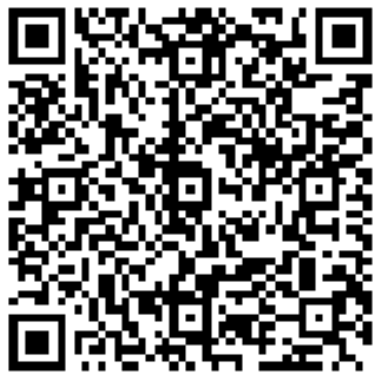
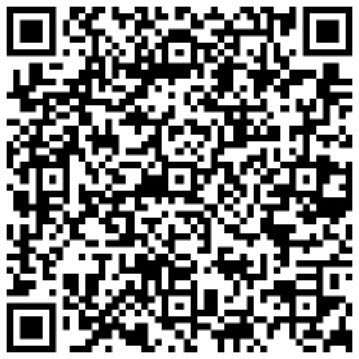
Your Vertex Team - Meet us at our booth H5
Julian Pauli
Solution Engineer
Principal
Norman Jokiel
Account Executive Principal
Quinten Blok
SAP Solution Engineer Lead
Bernd Fugger
Sales Director
Christine Kübler
Customer Relationship Manager
14
© Vertex, Inc. All rights reserved.

Slide 15
Julian Pauli
julian.pauli@vertexinc.com

